Slide 1


Introduction to MySQL

Slide 2
Introduction to Databases
It is very important to understand the database before learning MySQL.
A database is an application that stores the organized collection of records. It can be accessed and manage by the user very easily.
It allows us to organize data into tables, rows, columns, and indexes to find the relevant information very quickly.
Each database contains distinct API for performing database operations such as creating, managing, accessing, and searching the data it stores.

Slide 3
What is MySQL ?
MySQL is one of the most popular database management system software used for managing the relational database.
It is open-source database software, which is supported by Oracle Company. It is fast, scalable, and easy to use database management system in comparison with Microsoft SQL Server and Oracle Database.
It is commonly used in conjunction with PHP scripts for creating powerful and dynamic server-side or web-based enterprise applications.
Features
Easy to Use
Secure
Open Source
Scalable
Reliable

Slide 4
Database Management System (DBMS)
A database is a collection of data or records. Database management systems are designed to manage databases.
A database management system (DBMS) is a software system that uses a standard method to store and organize data.
The data can be added, updated, deleted, or traversed using various standard algorithms and queries.
Types
Hierarchical Databases
Graph
Databases
Network Databases
ER Model
Databases
Relational Databases
Document
Databases
Object-Oriented Databases
NoSQL
Databases

Slide 5
Relational Database Management System (RDBMS)
RDBMS stands for Relational Database Management System.
RDBMS is a program used to maintain a relational database.
RDBMS is the basis for all modern database systems such as MySQL, Microsoft SQL Server, Oracle, and Microsoft Access.
RDBMS uses SQL queries to access the data in the database.

Slide 6
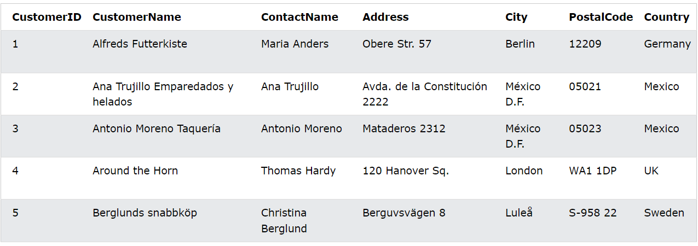
Relational Database Management System (RDBMS)
RDBMS stands for Relational Database Management System and it is a program used to maintain a relational database.
RDBMS is the basis for all modern database systems such as MySQL, Microsoft SQL Server, Oracle, and Microsoft Access. It uses SQL queries to access the data in the database.
Table in Database
Rows/Records/Tuples
Columns/Fields/Attributes

Slide 7
Normalization
Normalization is the process of organizing the data in the database.
Normalization is used to minimize the redundancy from a relation or set of relations. It is also used to eliminate undesirable characteristics like Insertion, Update, and Deletion Anomalies.
Normalization divides the larger table into smaller and links them using relationships.
The normal form is used to reduce redundancy from the database table.
Why do we need Normalization?
The main reason for normalizing the relations is removing these anomalies.
Failure to eliminate anomalies leads to data redundancy and can cause data integrity and other problems as the database grows.
Normalization consists of a series of guidelines that helps to guide you in creating a good database structure.

Slide 8
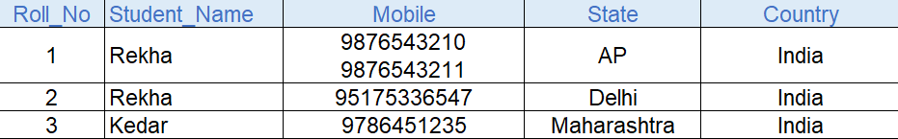
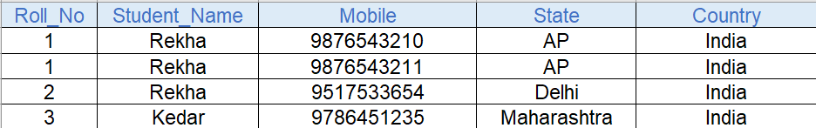
Normalisation Forms
1 NF
Each table cell should contain a single value.
Each record needs to be unique.
1st Normal form

Slide 9
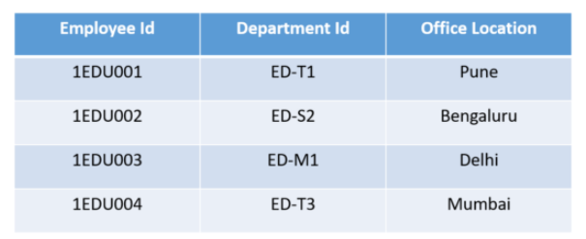
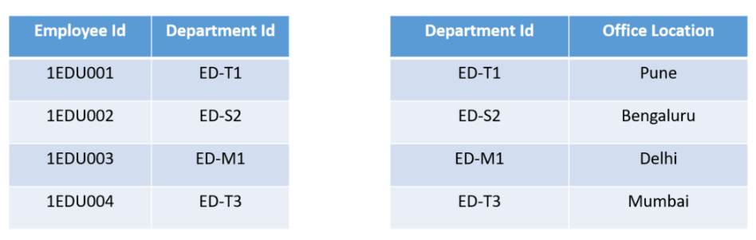
Normalisation Forms
2 NF
The table has to be in 1 NF.
Each column should be directly related to the primary key, and not to other columns.
2nd Normal form

Slide 10
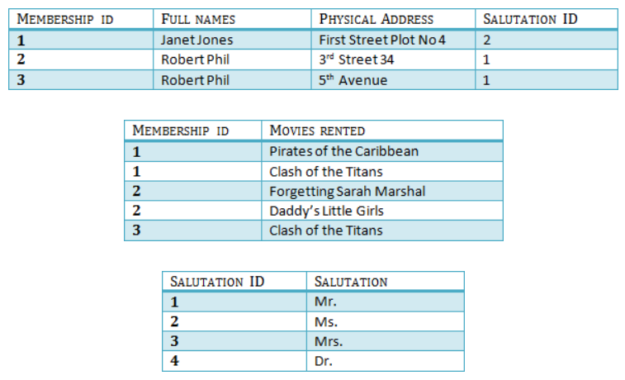
Normalisation Forms
3 NF
Be in 2NF
Has no transitive functional dependencies

Slide 11
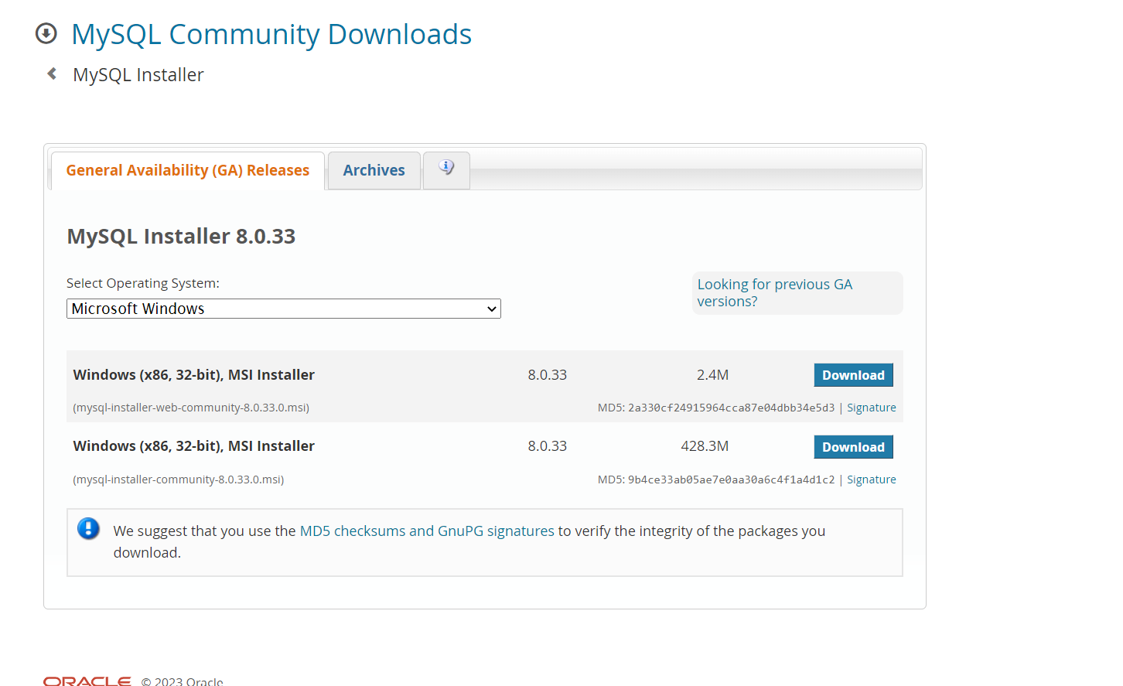
Software Installation
https://dev.mysql.com/downloads/windows/installer/8.0.html

